Slide 1
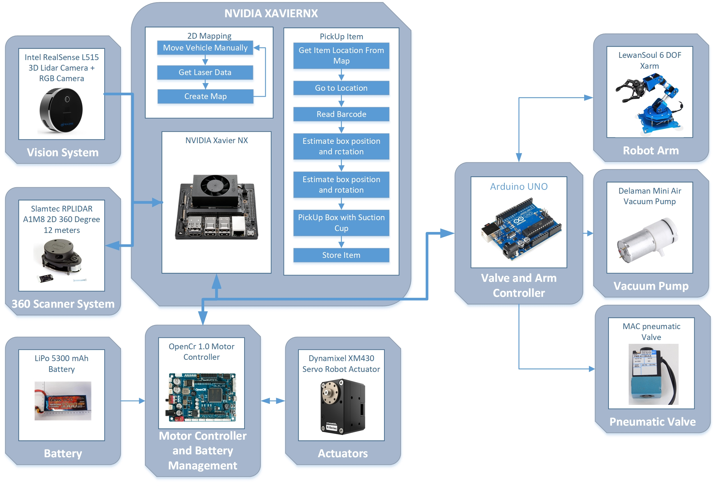
Mobile Automated Robotic Shelf Picking System – On development
By: Luis Chachayma - Jarosky Chachayma
PROJECT OVERVIEW
Robotic Systems are really useful when used to automate repetitive processes that are likely to involve human error if done manually. Talking specifically about warehouses and fulfillment centers there is a lot of human tasks that could be automated if the correct Autonomous system is designed.
The project purpose is to develop a Mobile Robotic System to pickup orders from customers. The project feasibility is based on the number of associates that work full time on the warehouse (10 people) and the similarity of the items to pickup (Small carboard boxes).
The project is being developed following the next considerations:
Warehouse mapping: The robot needs to map the Warehouse to find items quickly and to move efficiently.
Pickup System. The robot must be able to detect items spatially and be able to pickup up to 200 grams.
Autonomy. The system need to work with batteries and have an autonomy more than 2 hours.
IMPLEMENTATION
A Jetson Xavier NX is used as the main computer and is running ROS2 on a Linux Operating System.
For the object detection and rotation measurement an Intel RealSense 3D Lidar camera is used.
The mapping to locate the object in the warehouse is done using a 360 degrees Lidar sensor and Odometry with the Servos feedback
Servos Controller: The Servo Motors are being controlled by a OpenCR controller that also reads the battery status.
An Arduino UNO is used to calculate the Inverse Cinematics of the robotic arm and to control the vacuum applied to the suction cup.
General Diagram of the system setup
Notes:
1

